Slide 1
Maryland DNR’s Decommissioning Report August 19, 2024
Bob Sadzinski
Director, Power Plant Research Program

Slide 2
Report Overview
Decommissioning refers to the process of permanently removing a facility from operation.
Decommissioning aims to restore the site to its original condition to enable a range of potential uses for the land.
PPRP conducted a three-year study
PPRP reviews and makes recommendations to the PSC concerning solar decommissioning reports (N=82)

Slide 3
Power Plant Research Program (PPRP)
For the CPCN, PPRP:
Conducts a comprehensive, objective assessments based on sound science of electrical generation and transmission lines
Coordinates a consolidated State Agency review process
Make recommended conditions to the Public Service Commission (PSC)
The PSC has the authority to issue a CPCN
PPRP analyzes 70+ factors
Assume a 30-year lifespan for a solar project
.

Slide 4
CPCNs Filed in Maryland, 2011-2024

Slide 5
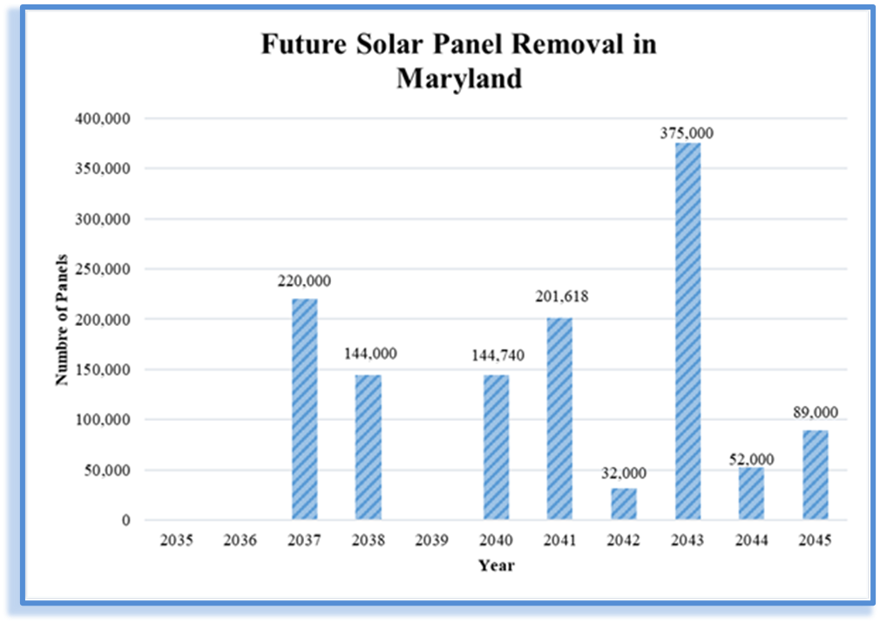
For Solar CPCN Projects ONLY
Source: PPRP’s Draft Cumulative Environmental Impact Report (CEIR - 21)

Slide 6
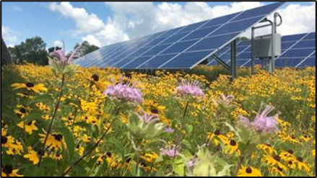
PPRP’s Recommended Decommissioning License Condition
Currently the required Decommissioning Plan is submitted as part of the CPCN Application
This is a dynamic
and ongoing process
PPRP Currently
Confirms the cost estimate from
the Applicant’s Third-Party
Requests five-year updates
Maximize reuse and recycling
Defines when Decommissioning should occur
“…at the end of the useful life of the Project or within 12 consecutive months of non-operation.”

Slide 7
PPRP’s Recommended Decommissioning Condition for Solar
27. Decommissioning
XXX shall implement the Decommissioning Plan, filed in Docket on July 8, 2024, incorporated into this CPCN, and as updated periodically in accordance with paragraphs (b) and (c) of this condition (Decommissioning Plan). In this respect, Community Power Group shall obtain a bond or letter of credit of not less than $577,000 from a financial institution prior to the start of construction to ensure that decommissioning costs are not borne by the State or County at the end of the Project’s useful life or in the event of abandonment of the Project. XXX has filed a request for repowering with the PSC, the Project will be considered abandoned if there is no electric generation to the grid for a period of twelve (12) consecutive months

Slide 8
PPRP’s Recommended Decommissioning Condition for Solar Cont’d
b. XXX shall update the Decommissioning Plan, cost estimate, and corresponding approved financial instrument every five (5) years after the PSC’s approval of the first Decommissioning Plan to adjust for inflation and any other necessary changes . XXX shall file a request for approval of the proposed updated plan and cost estimate in the Docket and provide copies to PSC Staff and Anne Arundel County for review prior to filing. After addressing comments from PSC Staff and the County and obtaining Commission approval, XXX shall file the updated Decommissioning Plan and cost estimate in the Docket and execute an adjustment to the financial guarantee mechanism.

Slide 9
PPRP’s Recommended Decommissioning Condition for Solar Cont’d
Updates to the Decommissioning Plan shall maximize component reuse and recycling, where practicable, and ensure all materials are handled in accordance with applicable federal, State, County, and local requirements. The Decommissioning Plan shall describe specific measures XXX will take to minimize landfilling of solar panel components. In future cost estimates, the salvage value of the panels may only be included as an offset to estimated decommissioning costs if XXX can provide evidence that a reuse and/or recycling market exists for such panels and the value is commercially supported. The allowable credit for salvage value must be limited to 85% of the documented commercial value of the salvaged materials to account for the expected salvage value variations over time..

Slide 10
PPRP’s Recommended Decommissioning Condition for Solar Cont’d
Except in the event of a pending request for repowering is filed with the Commission, Community Power Group shall begin implementation of the Decommissioning Plan at the end of the useful life of the Project or within 12 consecutive months of non-operation (defined as not generating electricity for sale). Prior to implementation of the Decommissioning Plan, XXX shall notify (via electronic or U.S. mail) PSC Staff and YY County of its intent to decommission

Slide 11
Solar Panel Recycling
Currently in the United States, approximately 10% of solar modules taken out of service are recycled.
As much as 90% of solar panel material is recycled in the European Union (EU)
Solar Panel Recycling is required in the EU
There is now a push to organize recycling of solar panels in the US

Slide 12
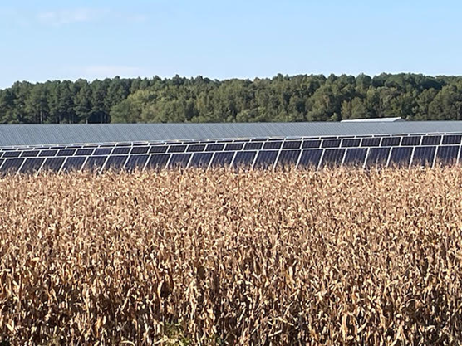
Soil Contamination from Solar Panels
Solar panels may contain potentially toxic/hazardous elements, including zinc, copper, nickel, gallium, lead, indium, cadmium, and chromium

Slide 13
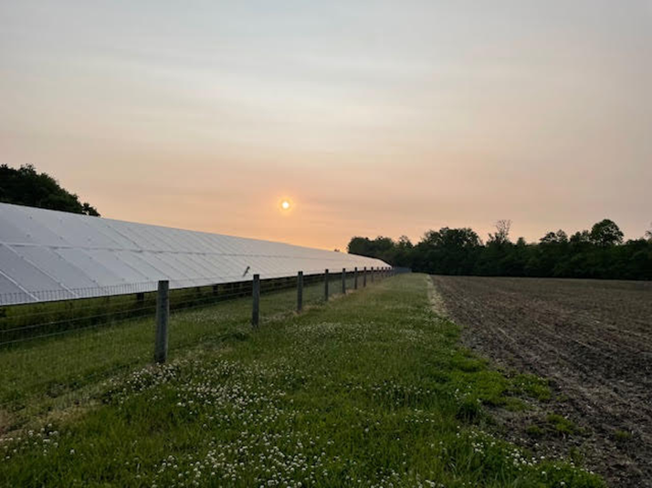
Solar Needed in Maryland to Reach the current RPS Solar Goal
Note this is an August 2024 update
Maryland needs to add approximately 5,000 MW of solar generating capacity (utility-scale plus distributed)
Or…..an additional ~25 million panels
Currently have 1,584 MWs of utility-scale solar installed in Maryland (11,000 acres)

Slide 14
Utility-Scale Solar Decommissioning
It is more than just Solar Panels
Includes removal of all components – underground wiring, pilings, transformers, etc.
Reestablish ground cover
Possible removal of vegetative buffer
Remove access roads and stone
Dependent on the current landowner and land use as to the extent of the reclamation
PPRP has not seen land lease agreements

Slide 15
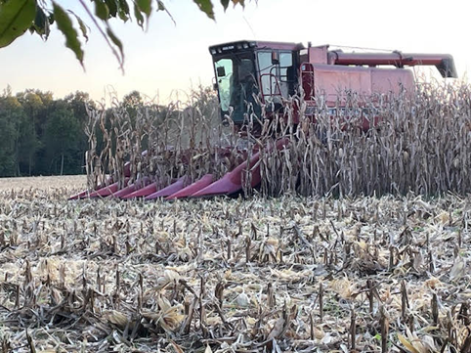
Decommissioning Costs
Owner/Applicant assumes the cost
Through the CPCN there is a bond/surety to ensure that cost is not borne by the State or County (numerous financial mechanism)
Through the PSC’s CPCN, decommissioning is reevaluated every five years
Notes:
Corp Guarantee, Surety Bond, Insurance, Letter of credit, sinking bond.

Slide 16
Cost of Decommissioning Through the CPCN
PPRP has reviewed ~ 70 Decommissioning Plans and we have concluded:
Estimated costs from Applicants are not consistent ($0- $95Kper acre)
Panels had the highest associated decommissioning costs
Applicants reduce the cost based on estimated recycling values.
The Decommissioning Plans are currently in the initial CPCN application to the PSC

Slide 17
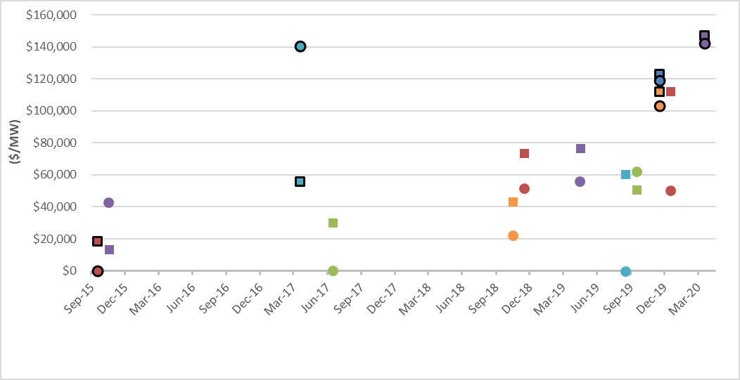
Multi-State Analysis of Decommissioning Costs Based on Filing Date

Slide 18
Conclusions
No solar site in Maryland that has a CPCN has been decommissioned (Oldest is ~ 15 years old)
Salvage value significantly reduces the decommissioning bond
PPRP’s proposed Decommissioning recommendation is not static

Slide 19
Conclusions – cont’d
Recycling and disposal of solar PV modules in the U.S. are at an early stage
Most solar panels that are decommissioned in the US are disposed in landfills
Decommissioning cost estimates will change as panels lose value and changes in the salvage value of material
The report will be available as a pdf.

Slide 20
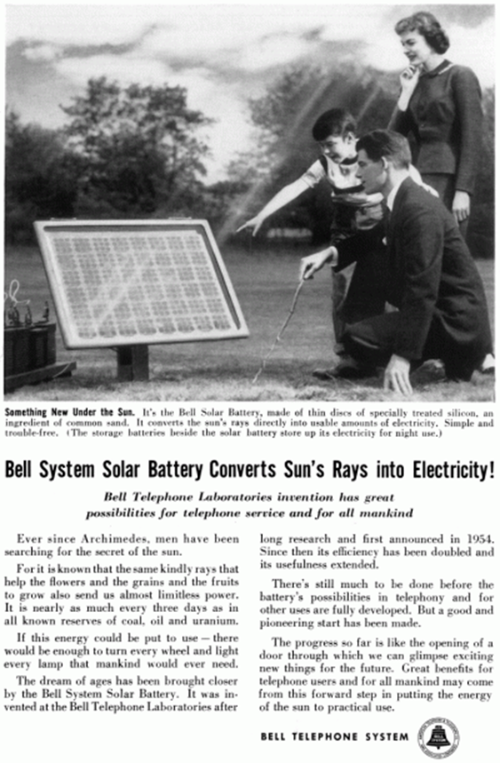
Thank You!
Questions?

